Slide 1
Stacks

Slide 2
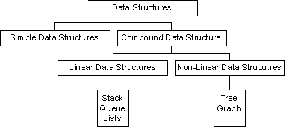
Classification of Data Structures

Slide 3
Stacks
A stack is a data structure of elements that are inserted and removed according to the last-in first-out(LIFO) principle.
In the pushdown stacks only two operations are allowed: push the item into the stack, and pop the item out of the stack.
A stack is a limited access data structure - elements can be added and removed from the stack only at the top
Push adds an item to the top of the stack, pop removes the item from the top.
Stack of plates, books

Slide 4
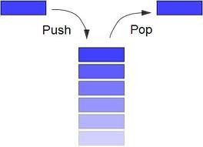
Stacks Contd..
A stack may be implemented to have a bounded capacity.
Overflow Condition.
Under flow Condition

Slide 5
Stack Example
Operation | Output | Stack Contents
push(5) | - | (5)
push(7) | - | (5,7)
push(3) | - | (5,7,3)
pop() | 3 | (5,7)
size() | 2 | (5,7)
push(4) | - | (5,7,4)
pop() | 4 | (5,7)
pop() | 7 | (5)
size() | 1 | (5)
pop() | 5 | ()
pop() | “error” | ()

Slide 6
Implementation of Stack – push()
void push()
{
int element;
if(top==size-1)
printf("Stack Overflow");
else{
printf("enter an element\t");
scanf("%d",&element);
top++;
stack[top]=element;
}
}

Slide 7
Pop() implementation
void pop()
{
int ele;
if(top==-1)
printf("stack underflow");
else
{
ele=stack[top];
printf("%d is popped", ele);
top--;
}
}

Slide 8
display()
void display()
{
int i;
if(top!=-1)
{
for(i=0;i<=top;i++)
printf("%d\t",stack[i]);
}
else
printf("Empty stack");
}

Slide 9
Disadvantages of stack using Arrays
Drawback:- we cannot place elements more than the size of an array.

Slide 10
Using Linked Lists
struct node
{
int data;
struct node*next;
}*newnode,*temp;

Slide 11
void push()
{
int element;
new=(struct node *) malloc(sizeof(struct node));
printf("Enter element to be pushed");
scanf("%d", &element);
if(top==NULL)
{
new->data=element;
new->next=NULL;
top=new;
}
else{
new->data=element;
new->next=top;
top=new;
}
}

Slide 12
void pop()
{
int ele;
if(top==NULL)
printf("stack is empty");
else
{
temp=top;
ele=top->data;
printf("%d element is deleted", top->data);
top=top->next;
temp->next=NULL;
free(temp);
}
}

Slide 13
display()
{
temp=top;
while(temp!=NULL)
{
printf("%d", temp→data);
temp=temp→next;
}
}

Slide 14
Stack Applications:
Stack is used by compilers to check for balancing of parentheses, brackets andbraces.
Stack is used to evaluate a postfix expression.
Stack is used to convert an infix expression into postfix/prefix form.
In recursion, all intermediate arguments and return values are stored on the processor stack.
During a function call the return address and arguments are pushed onto a stack and on return they are popped off.
Depth first search uses a stack data structure to find an element from a graph.

Slide 15
Insertion at the ending
void push()
{ int value;
new=(struct node*)malloc(sizeof(struct node));
printf("enter value:");
scanf("%d",&value);
new->data=value;
new->next=NULL;
tail->next=new;
tail=new;
}

Slide 16
Deletion at Ending
void delte_end()
{
temp=head;
while(temp->next!=tail)
{temp=temp->next;
}
temp->next=NULL;
tail=temp;
}

Slide 17
Count number of Nodes
int num_nodes()
{
int count=0;
temp=head;
while(temp!=NULL)
{ count++;
temp=temp->next;
}
printf("%d",count);
}

